Slide 1
SUPERVISED LEARNING USING R
CIS Fraud Detection

Slide 2
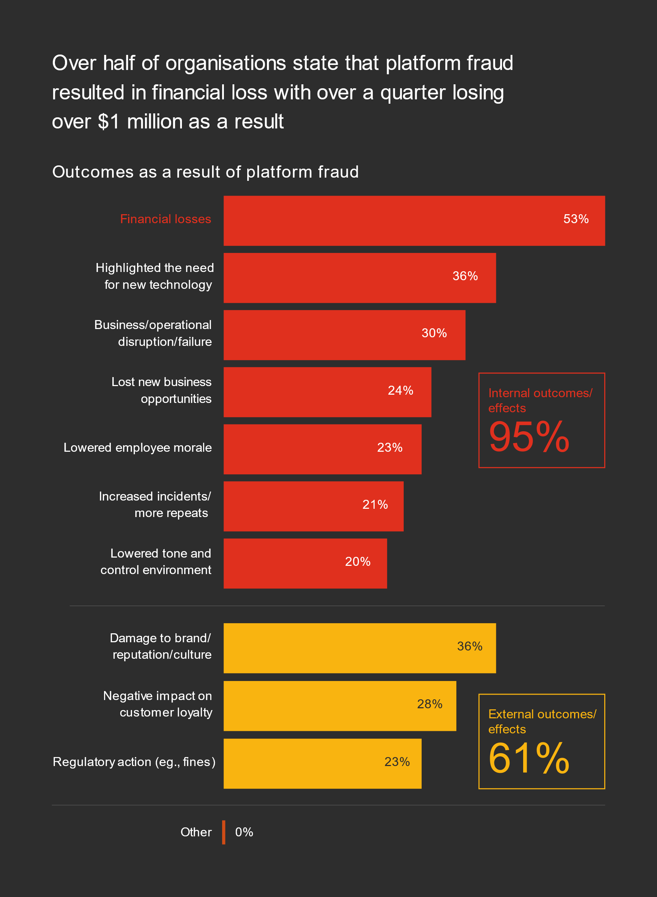
Global Economic Crime and Fraud Survey by PWC (PricewaterhouseCoopers)

Slide 3

Urbanus Kathitu
Robert Ng’ang’a
Anthony Njoya
Faith Muigai
Virginia Kamande

Slide 4

Problem
The objective is to improve fraud prevention systems in the payment industry, thus:
Saving consumers millions of dollars
Improving customer experience
Helping hundreds of thousands of businesses reduce their fraud loss and increase their revenue
Mitigating the hassle of false positives

Slide 5


Data Source: Vesta Corporation
The forerunner in guaranteed e-commerce payment solutions.
Founded in 1995, Vesta pioneered the process of fully guaranteed card-not-present (CNP) payment transactions for the telecommunications industry.
Vesta has since expanded data science and machine learning capabilities across the globe and solidified its position as the leader in guaranteed ecommerce payments.

Slide 6

Today, Vesta guarantees more than $18B in transactions annually!

Slide 7

Research Question

Slide 8
Objectives
To develop a machine learning model that accurately detects fraudulent card transactions using various transactional and behavioral features
To determine the number of fraudulent transactions
To determine the number of normal transactions in the dataset.

Slide 9


Target Variable: isFraud
It indicates whether a transaction is fraudulent or not

Slide 10

Observations
There are a lot of missing values in datasets, some with more than 80% missing data. We are only keen to look at features with less than 30% missing data.
Our column include TransactionID, isFraud, TransactionDT, TransactionAMT, ProductCD, card1 - card6, addr 1 & 2, dist1 & 2 P_ and (R__) emaildomain, C1-C14: counting, D1-D15: timedelta, M1-M9, V1-V339, id_1 – id_38, DeviceType, DeviceInfo

Slide 11
Process
Step 1: Loading Libraries
Load the necessary R packages for data manipulation and analysis, such as tidyverse, readr, and dplyr
Step 2: Load Dataset
Load the dataset into R using the read_csv ( ) function from the readr package
Step 3: Data Preprocessing
Clean and preprocess the data as needed. This may include removing missing values, transforming variables, and encoding categorical variables
Step 4: EDA
Perform exploratory data analysis (EDA) to gain insights into the data and identify patterns or relationships.
Included creating visualizations, calculating summary statistics, and using statistical tests.

Slide 12
Process
Step 5: Algorithms
Step 6: Splitting Data
Step 7: Model Training and Hyperparameter Tuning
Step 8: Predictions
Involved choosing a supervised machine learning algorithm that is appropriate for the problem we are trying to solve. Examples of algorithms that we used for fraud detection include, decision trees, and random forests
Split the data into training and testing sets using the sample ( ) function or a package like caret.
Train the model on the training set, evaluate its perfromance on the testing set, and fine-tune it as needed.
We used cross validation hyper-parameter tuning to improve the performance of the model.
Use the trained model to make predictions on new data, such as the test dataset provided

Slide 13
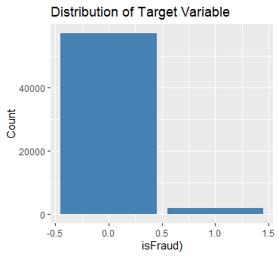
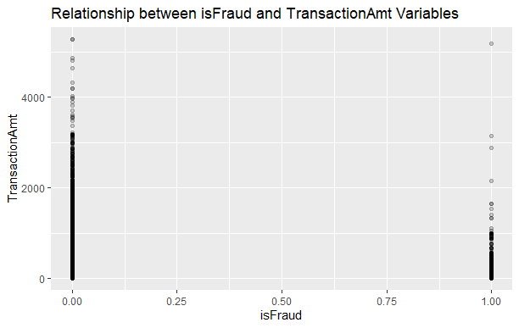

Slide 14
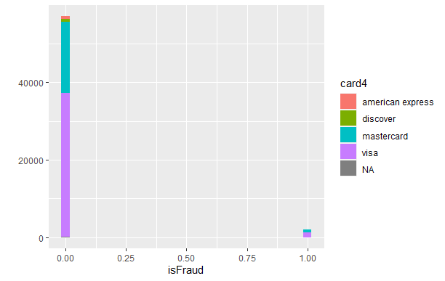
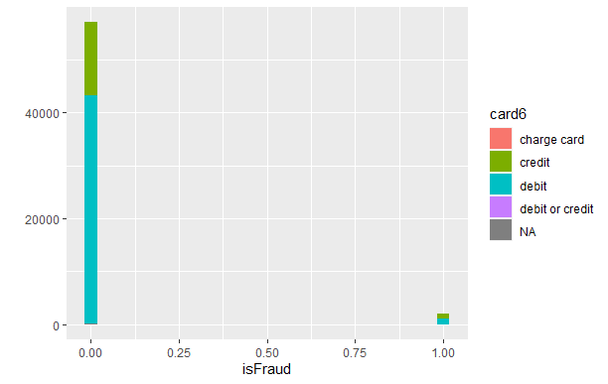

Slide 15
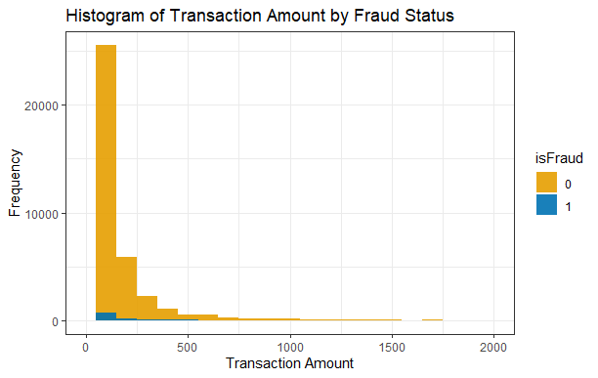
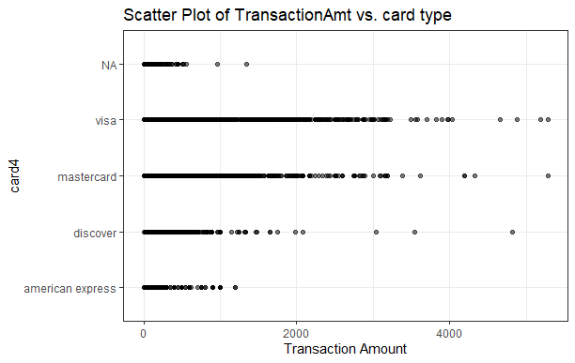

Slide 16
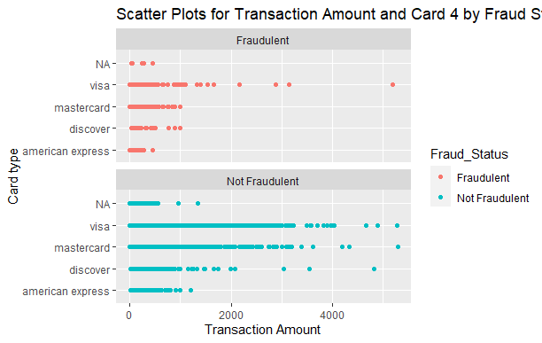
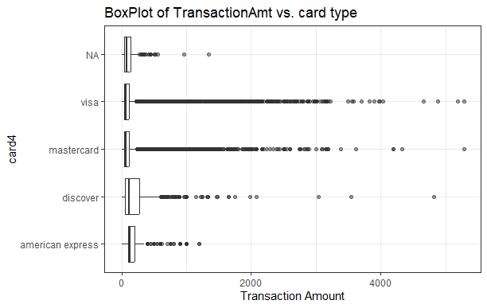

Slide 17


Model Evaluation of the “Fraud Detection” Dataset
Outcome
We used accuracy metrics to help measure the performance of the model and determine the most accurate model for the problem at hand.
The Gradient Boosting Model achieved the highest accuracy

Slide 18

Observations
1. "TransactionAmt" and "TransactionDT" are important predictors: These two variables are likely to have a strong influence on the model's predictions. "TransactionAmt" represents the amount of money involved in the transaction, and "TransactionDT" represents the time elapsed since the first transaction in the dataset. Both of these variables are likely to be important predictors of fraud.
2. "card4" and "card6" variables can also be useful: "card4" and "card6" variables represent the credit card issuer and type, respectively. These variables could provide additional information that may help to distinguish fraudulent transactions from non-fraudulent transactions.
3. The model's performance may be affected by class imbalance: The dataset is imbalanced, with a relatively small number of fraudulent transactions compared to non-fraudulent transactions. This may make it more challenging for the model to accurately identify fraudulent transactions.
4. Further feature engineering or selection may be necessary: While these variables provide some predictive power, additional variables or feature engineering may be needed to improve the model's accuracy.

Slide 19

Conclusion
By implementing these recommendations, the efficacy of fraudulent transaction alerts can be improved, reducing fraud loss for businesses and saving customers the hassle of false positives.

